Slide 1
PeDX
(Pen-plus Database)

Slide 2
Introduction
-
PedX is the Database for managing and reporting PEN-Plus status in Tanzania. Is web System application that helps to collect information for the current projects that is going on for two district hospitals ,Kondoa Hospital in Dodoma region and Karatu Hospital in Arusha region.
-

Slide 3
Introduction...
Purpose of the presentation is to show Slides on how was developed, significance of using it, security, confidentiality of data and few demos of how to navigate, view data and reports.

Slide 4
Key Features
Centralized Data Repository: It store data for multiple sites.
Data Accessibility: User-friendly interface and secure access controls to facilitate collaboration and data sharing.
Data Integration: Ability to integrate data from diverse sources to enable comprehensive analysis.

Slide 5
Key Features…..
- Data Integration: Ability to integrate data from various sources ( public databases, etc.) into a unified platform.
- Scalability: The system handles multiple sites data as the research progresses.
- Metadata Management: Efficient organization/Institution and annotation of datasets for easy retrieval and analysis.

Slide 6
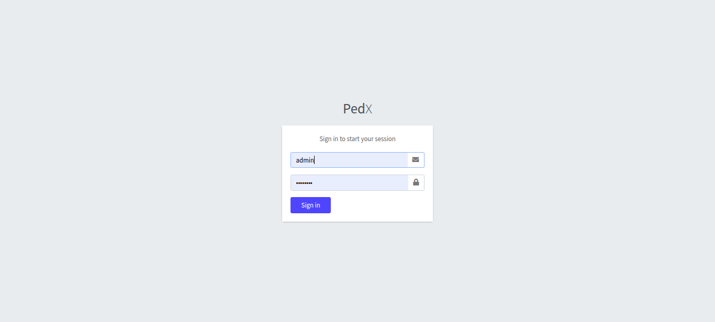
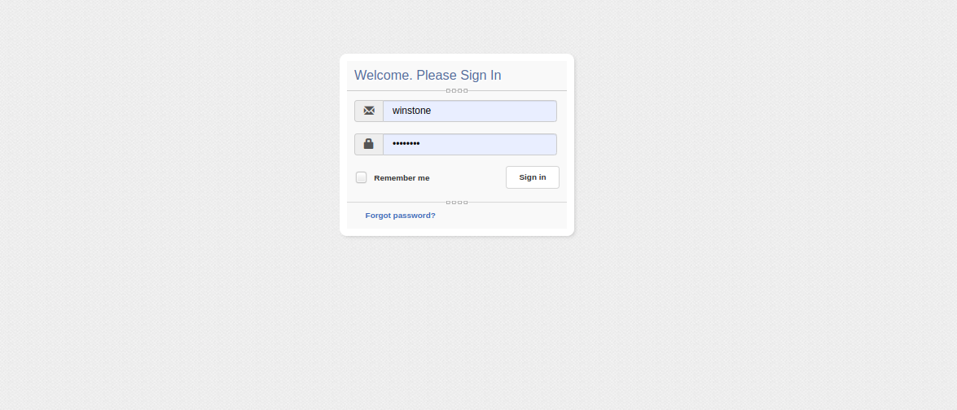
User interface….
Login Page

Slide 7
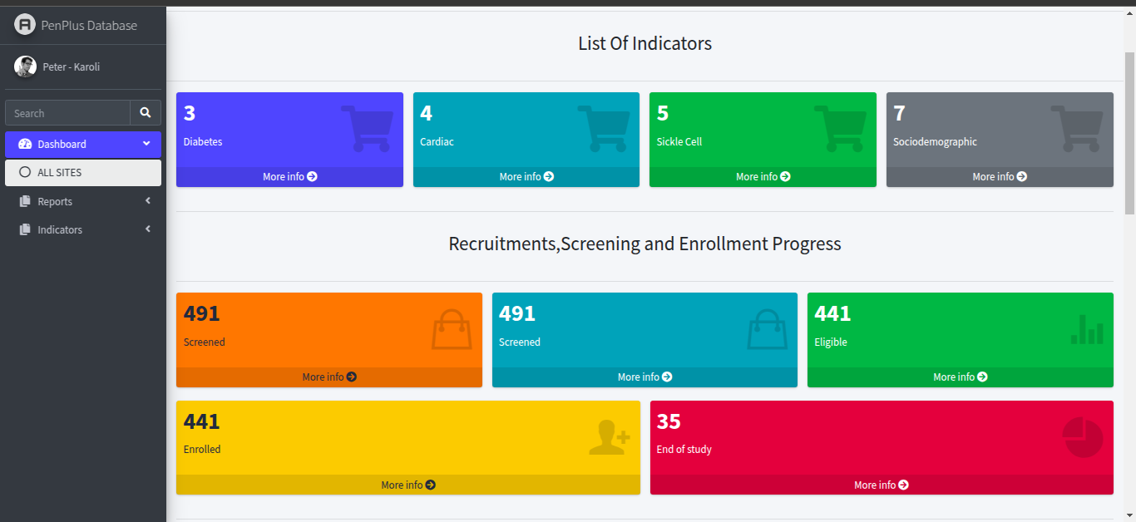
User interface….
Home Page 1

Slide 8
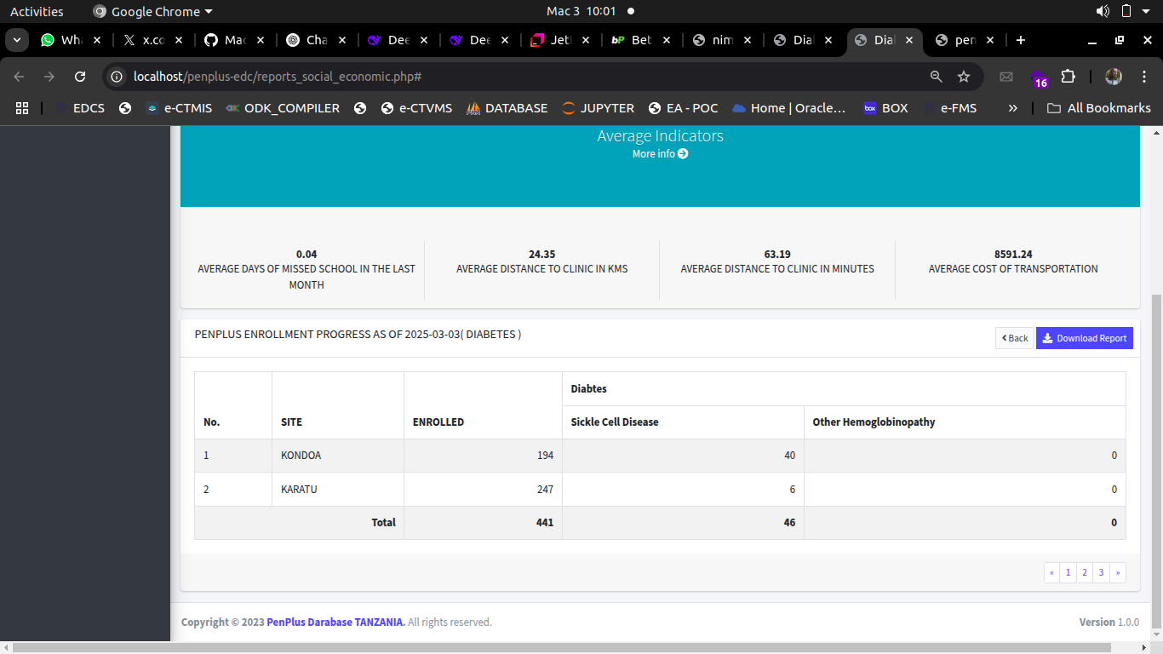
User interface….
Specific Indicator Page(Socialdemographic)

Slide 9
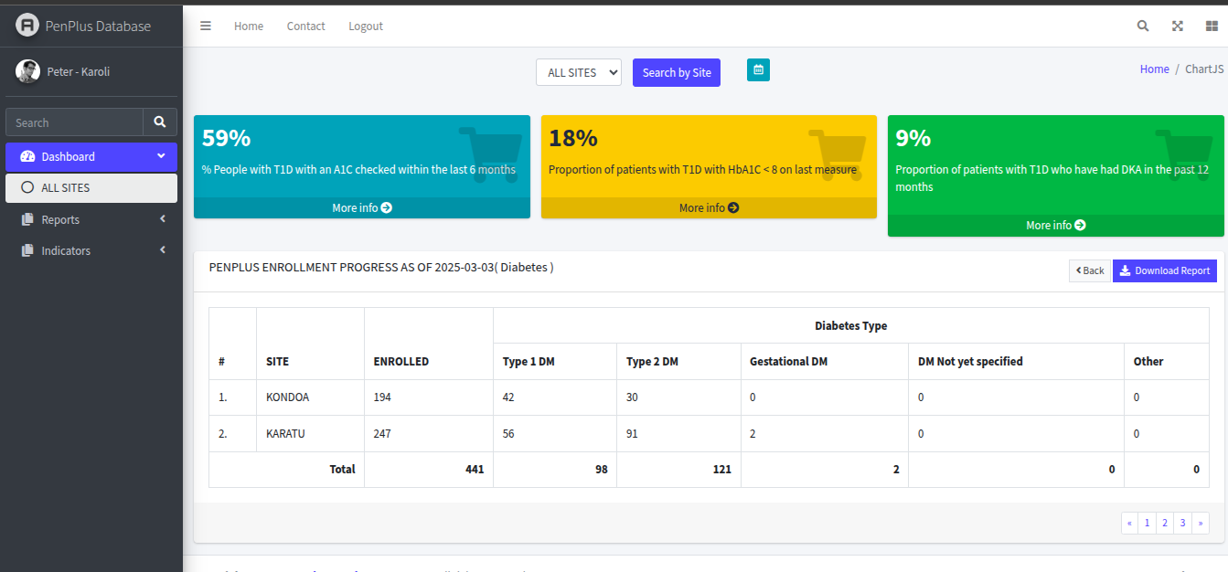
User interface….
Specific Indicator Page(Diabetes)

Slide 10
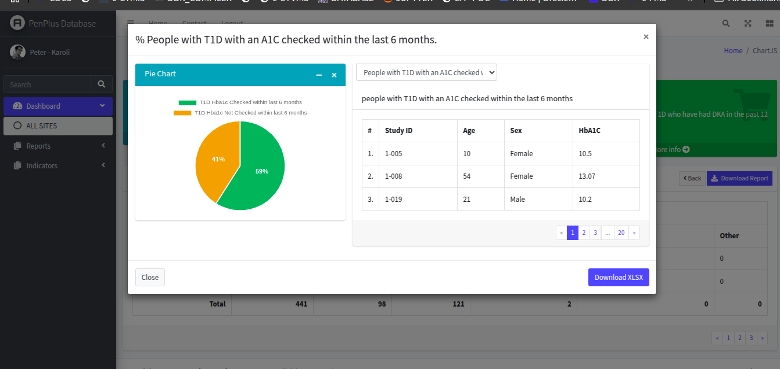
User interface….
Visual of Specific Indicator Page

Slide 11
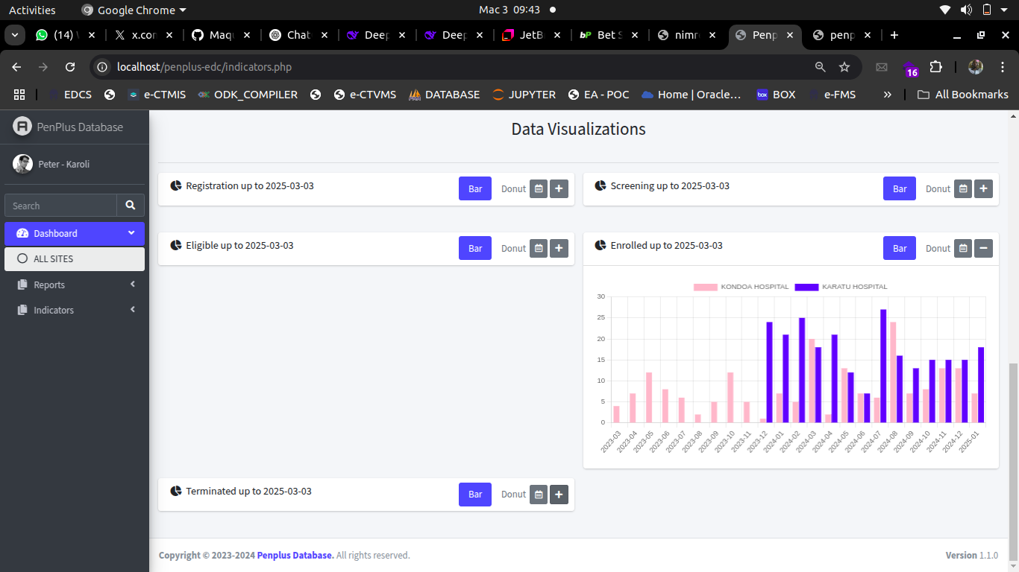
User interface….
Visual Progress Summary

Slide 12
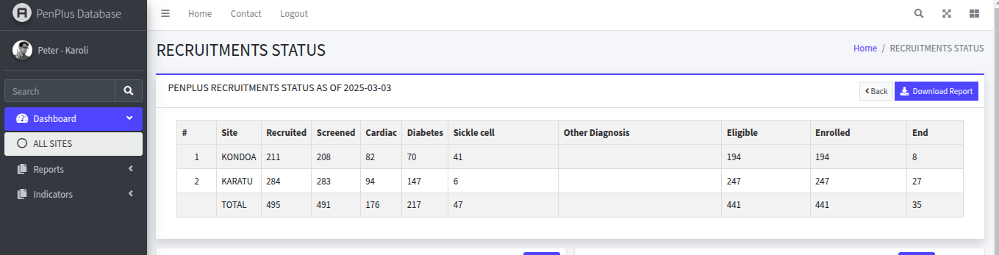
User interface….
Progress Summary

Slide 13
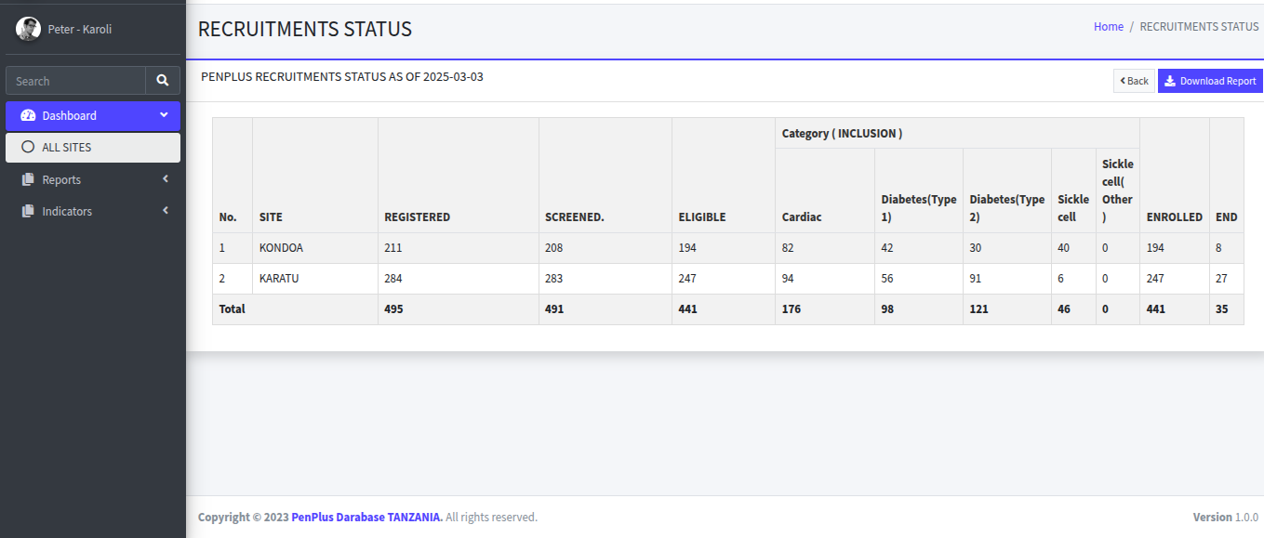
User interface….
Progress Summary Per Disease

Slide 14
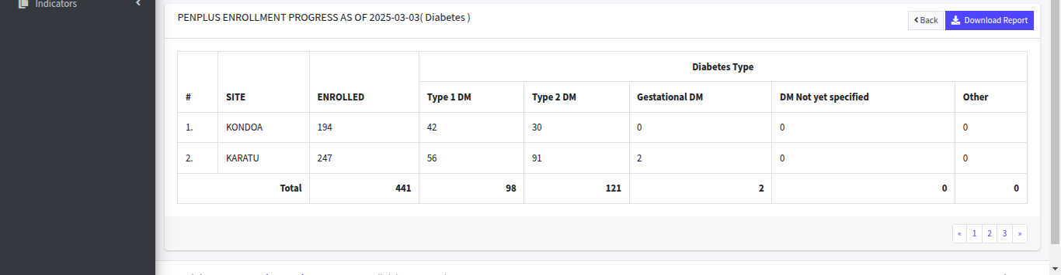
User interface….
Progress Summary Per Disease
(Diabetes Details)

Slide 15
User interface….
Progress Summary Per Disease
(Sickle Cells)

Slide 16
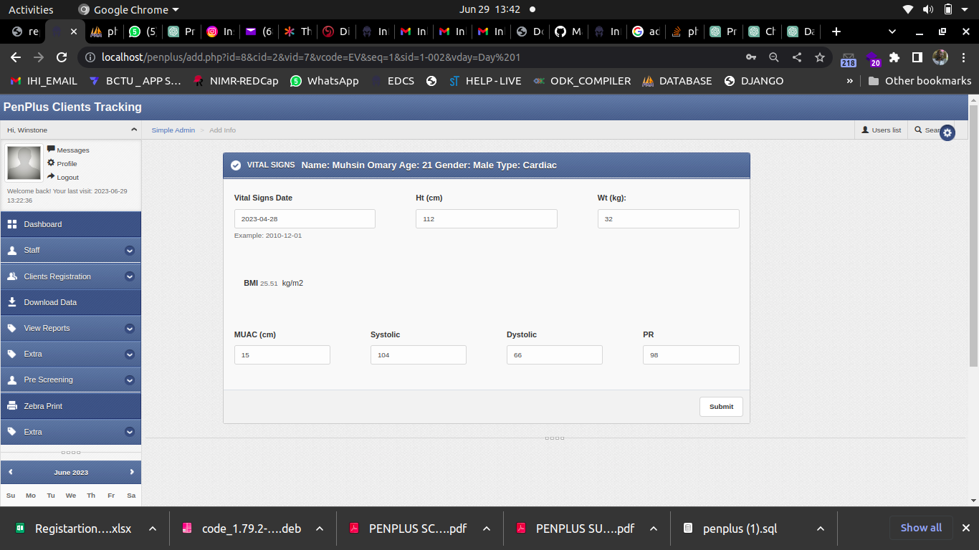
User interface….
Input Form

Slide 17
Security and Privacy:
User login password :- Only authorized user can access the system, system forces user to create strong password after first time login.
No sql injections during inserting information to databas(codes are well prepared to remove special characters)

Slide 18
Data Backup
Backup of database and data is performed weekly and stored to Drive which stored in secured place with limited people access

Slide 19
Benefits
- Accelerated Discoveries: Efficient data management enables researchers to quickly access and analyze data, leading to faster discoveries.
- Enhanced Collaboration: Collaborative features foster teamwork and knowledge exchange among researchers.

Slide 20
Benefits….
- Data Integrity: Ensuring data accuracy and consistency leads to reliable research outcomes.
- Improved Efficiency: Streamlined processes and automated tasks reduce manual effort and save time.
- Compliance and Security: Robust security measures and compliance with data protection regulations safeguard sensitive research data.

Slide 21
Implementation Considerations
- Cost: Evaluate the affordability and return on investment of the data management system.
- Scalability: Ensure that the system can handle increasing data volumes and evolving research requirements.
- Training and Support: Assess the availability of training resources and technical support for system users.

Slide 22
Implementation Considerations…...
- Data Migration: Plan for seamless migration of existing data into the new system without data loss.
- Integration with Existing Infrastructure: Determine compatibility with current research tools and workflows.

Slide 23
Thank You
Data is power

